Slide 1
Chapter 7 – Image Manipulations, Audio, and Video
1
Positioning Images
Shortcut Icon
iframe Element
Audio
Background Image
Web Fonts
Video
Notes:
1. In this chapter I demo these files:
trees.html
artExhibit.html
halloweenSounds.html
tvAds.html
To get the sound and video to work on Park’s web server, I had to ask ITS to add the following file formats to their IIS server:
*.mp3: mime type="audio/mpeg"
*.wav: mime type="audio/wav"
*.ogg: mime type="audio/ogg"
*.ogv: mime type="video/ogg"
*.webm: mime-type="video/webm"
For the Halloween Sounds web page, I asked ITS to add the following web font file formats to their IIS server:
.woff, .ttf, .otf, and .eot

Slide 2
Positioning Images
The img element is a phrasing element, so it gets displayed within the normal flow of its surrounding text.
That works well for small pictures (icons), but not so well for medium and large pictures.
Normally, for a larger picture, you should:
  Display it on a line by itself by surrounding it with a block element.
    or
  "Float" it to the left or to the right so surrounding text prints along its borders.
To float an image, apply CSS's float property to the img element, using a left or right value.
1
2
3
4
5
Notes:
1. See the smiley on the next slide and return here.
2. What's an icon? A small image file.
3. I show trees.html (which has the floatLeft and floatRight selectors removed) in a browser and point out the wasted space next to the big pictures.
4. I show the next slide - Note how the pictures are floated to the left and to the right.
Let's edit trees.html so the browser web page looks like the slide's web page.
I load the trees.html file in my editor.
I add these rules:
.left{float: left;}
.right{float: right;}
I add these attributes to the two lowest img elements:
class="left", class="right"
I show the result.
5. I show the fixed code with the float rules 2 slides later.

Slide 3
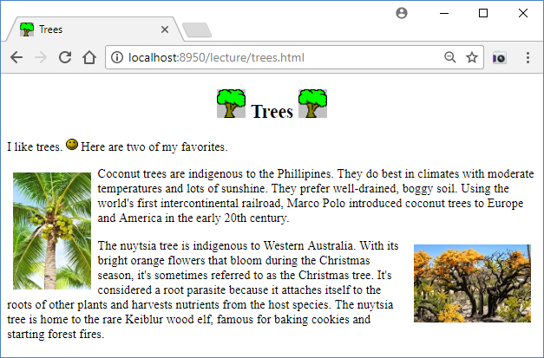
Positioning Images

Slide 4
Positioning Images
Here are the style and body containers for the Trees page:
  <style>
  h2 {text-align: center;}
  .left {float: left; margin: 8px;}
  .right {float: right; margin: 8px;}
  </style>
  <body>
  <h2>
  <img src="../images/tree.png" width="37" height="37" alt="">
  Trees
  <img src="../images/tree.png" width="37" height="37" alt="">
  </h2>
  <p>
  I like trees. <img src="../images/smiley.gif" width="15" height="15" alt=""> Here are
  two of my favorites.
  </p>
  <p>
  Peach trees are indigenous to China. Using the world's...
  <img class="left" src="../images/peach.jpg" width="134" height="101" alt="">
  Peach trees do best in climates with cool damp conditions...
  </p>
  <p>
  <img class="right" src="../images/nuytsia.jpg" width="79" height="132" alt="">
  The nuytsia tree is indigenous to Western Australia. With its...
  </p>
  </body>
2
Center the heading’s content.
1
Float the photographs to the left and to the right.
Notes:
1. Note the left and right CSS rules and their class attributes.
2. Note the h2 rule.
In the past, we’ve centered a heading element’s text with text-align: center.
This time, we’re using that same technique for centering the text plus two icons all within a heading element.
Despite its name, the text-align property aligns more than just text – it aligns all inline content within an element, and img elements are inline content.

Slide 6
Shortcut Icon
To mark your web page with a shortcut icon in the browser's tab area, in your web page's head container, include a link element with rel="icon". For example:
  <link rel="icon" href="../images/tree.png">
  The rel attribute specifies the relationship between the current web page and the linked-to entity.
  For shortcut icons, the W3C recommends using a GIF or PNG file with dimensions of 16x16 pixels or 32x32 pixels.
  Normally, for the sake of cohesiveness, you should use the same shortcut icon for all the web pages on your website. That's why shortcut icons are sometimes called website icons.
  Shortcut icons are also called bookmark icons because when you display your bookmarks/favorites list, the icons appear next to the names in the list.
  Shortcut icons are also called favicons , for favorite icons.
1
2
3
4
5
Notes:
1. In my IDE, note that the tree.png file is already in the images directory (because we display it in the trees web page body).
Below the title element, I add the link element.
I then view the page in a browser and note the icon in the tab area.
2. What else have we used the link element for?
To link to an external CSS file.
For an external CSS file, what value should you use for the rel attribute?
rel="stylesheet"
3. If you use an image file with dimensions different from 16x16 or 32x32, the browser will adjust it, so it fits in the tab area.
However, I like to avoid that adjustment to prevent possible degradation.
[4. http://www.w3.org/2005/10/howto-favicon says you should use GIF, PNG, or ICO files for shortcut icons.
Wikipedia says:
The ICO file format is an image file format for computer icons in Microsoft Windows.
ICO files contain one or more small images at multiple sizes and color depths, such that they may be scaled appropriately.
In Windows, all executables that display an icon to the user, on the desktop, in the Start Menu, or in Windows Explorer, must carry the icon in ICO format.]
5. There's no official pronunciation, but most people say "FAV - ih-con." Sometimes "FAVE-ih-con."
[If you store a favicon.ico file in your web server's root directory, the major browsers will find it and use it.
However, the W3C recommends not relying on that technique because it depends on the web server.]

Slide 7
iframe Element
An iframe (short for inline frame) element creates a browsing context. A browsing context is an area within a web page that can display an embedded web document (a web document is something with a URL; e.g., a web page or a stored image).
Usually, instead of loading an entire web page within an iframe area, web programmers will load a stored image in an iframe area. For example, in the web page on the next slide, an iframe displays the large picture.
If you click one of the thumbnail pictures, a larger version of it appears at the right.
1
2
3
Notes:
1. What is a thumbnail?
A thumbnail is a reduced-size version of a picture, usually used with other thumbnails to help organize and retrieve the larger-version pictures.
Depending on your settings, if you look at a folder of pictures in File Explorer, you'll see thumbnails to help identify the actual, larger pictures.
2. I demo artExhibition.html in Chrome.
[3. In earlier versions of HTML, there was a frame element; it was similar to iframe, but worse.
With multiple frame elements in a web page, you could use each frame to display a separate web page.
Although the frame element was quite popular in the 90’s, it fell out of favor because:
The "framed" web pages are difficult to bookmark.
The back button is difficult to use.
The iframe element is similar to the frame element, but it has fewer problems and some cool new features (like a sandbox area).]

Slide 8
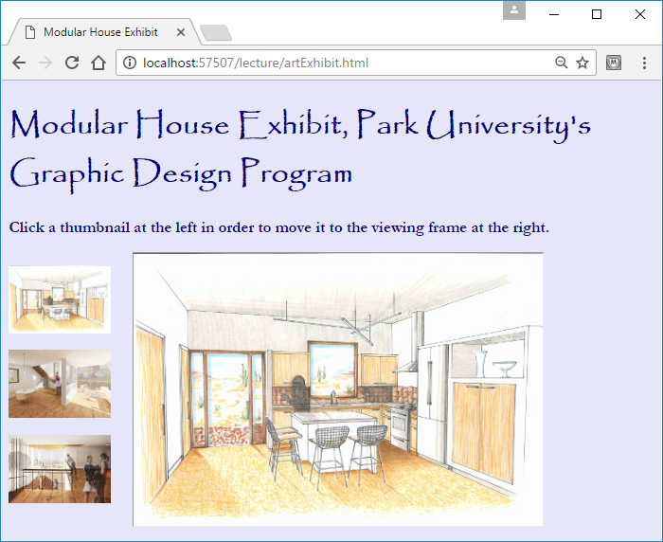
iframe Element

Slide 9
iframe Element
The following code creates a browsing context area that’s used to display the larger image as shown on the previous slide.
  <iframe class="cell" name="full-size"
  width="480" height="320"
  src="../images/houseRenderings/kitchen.jpg"></iframe>
Use the name attribute to specify a name for the iframe element, so the element can be used as a target for a link later on.
2
1
Use the src attribute to specify the web document that the browsing context displays.
3
Notes:
1. Note the src attrbute's value.
You can use src to specify the path to another web page, but here we're using it specify the path to an image file.
2. In order to load a new portrait into the browsing context area, we need to be able to refer to the iframe element, and the name attribute value allows us to do that.
What name will we use to refer to the iframe element?
full-size!
[3. Typically, browsers display a faint border around the iframe’s browsing context that distinguishes it from the rest the web page’s content. Normally, you’re going to want to avoid that behavior. To get the browsing context to integrate seamlessly with the rest of the Art Exhibit web page, we use the following CSS rule:
iframe {border: none; overflow: hidden;}
The HTML5 standard had a seamless attribute that instructed the browser to render the browsing context area so it appears to be part of the containing document.
But browsers didn't support the seamless attribute, so the W3C gave up and removed the seamless attribute.]

Slide 10
iframe Element
The following code creates thumbnail image links to larger images that will be displayed in the full-size iframe when the link is clicked:
  <a href="../images/portraits/man.jpg" target="full-size">
  <img src="../images/thumbs/thumbMan.jpg" alt="man"></a>
  ...
  <a href="../images/portraits/girl.png" target="full-size">
  <img src="../images/thumbs/thumbGirl.png" alt="girl"></a>
1
2
3
Use the target attribute to specify where to open the image.
Notes:
1. As always for an a element, the href attribute indicates what to load.
In the past, we've only loaded another web page, but you can also load a picture.
2. The target attribute tells the browser to open the picture in the full-size browsing context.
What would happen if there were no target attribute?
Do you know the default value for the target attribute?
It's _self, which tells the browser to overlay the current web page with the href value.
In my editor, I delete one of the target attributes and demo the updated web page.
3. Normally, for a user to activate a link, the user clicks on the link's text.
But in this case, we're using thumbnail images instead of text for the things that the user clicks.

Slide 11
Audio
In the past, users had to install a plug-in to play sound from a web page.
HTML5 provides an audio element, which allows users to play audio files directly from their browsers without the need of a plug-in. For example:
  <audio src="../audio/witchesCackle.mp3"
  preload="auto" controls></audio>
1
2
Notes:
1. Note that the audio element requires a start tag and an end tag.
Later, I'll show you optional content you can put between the two tags.
2. Note that the example uses an mp3 file.
I'll talk about different audio file types on the next slide.

Slide 12
Audio
Attributes for the audio element:
  src – Specifies a path to an audio file.
  controls – Causes an audio control bar to display (start, pause, and volume).
    When you specify an attribute (like controls) by itself, that's known as an empty attribute.
    As an alternative to using empty attribute syntax, you can specify a dummy value or empty string like this:
      controls="controls"
      controls=""
  preload="auto" – Suggests to the browser to download the audio file when the page initially loads as opposed to when the user presses start on the control bar.
  autoplay – Causes the audio file to start automatically when the page first downloads (with autoplay, there’s no need to specify preload).
  loop – Causes the audio file to play repeatedly.
1
2
3
4
5
Notes:
1. You should always include the controls attribute.
If you don't, your users will probably be annoyed that they can't control the sound.
2. Google's style document doesn't say which technique they prefer, but I prefer that you use an empty attribute where the attribute is by itself.
3. Why is preload helpful?
By starting the download right away, you can reduce the wait time when the user clicks the play button.
But the browser uses the preload attribute only as a suggestion – it’s ultimately up to the browser to decide whether to download the audio file or its meta information before the user clicks the play button.
When would you not want to preload?
If you have limited bandwidth on your web server, and your user does not end up choosing to play the audio file, you'll unnecessarily cause other downloads to slow down and you'll spend more money (depending on your network provider plan).
Preloading is particularly bad if you do it for lots of audio elements on the same web page.
4. When should you use autoplay?
For sounds that are meant to be played in the background.
With autoplay, even though you're forcing the user to listen to the audio file initially, you should still include the controls attribute, so the user can turn off the sound if he/she wants to.
5. Use the loop attribute sparingly - only if it's appropriate to repeat the sound.

Slide 13
Audio
  Unfortunately, different browsers support different audio file formats. To handle that situation, you can omit the audio element's src attribute and, instead, include source elements between the audio element's start and end tags. For example:
    <audio autoplay controls loop>
    <source src="../audio/rainStorm.mp3" type="audio/mpeg">
    <source src="../audio/rainStorm.wav" type="audio/wav">
    <source src="../audio/rainStorm.ogg" type="audio/ogg">
    </audio>
  For maximum browser compatibility, you should include source elements for these three popular audio file formats: .mp3, .wav, .ogg
  To help the browser determine whether it's capable of displaying a particular audio file, you should include a type attribute, as shown above.
  If you find only one file format for a particular sound, use a file converter (e.g., http://www.online-convert.com) to create files with the other formats.
1
2
3
4
Notes:
1. The browser will load the first file that uses a format that the browser supports.
2. Modern browsers should support all 3 audio formats, but older browsers have less support, so for the next several years, you might want to provide multiple source elements with multiple file formats.
[3. The type attribute is part of the source element specification, but not part of the audio element specification.
4. You can use the http://hpr.dogphilosophy.net/test/ web page to test what audio file formats are supported.]

Slide 14
Audio
Here is the body code for a Halloween Sounds web page at http://teach.park.edu/~jdean240/lecture/halloweensounds.html:
  <body>
  <h1>Halloween Sounds</h1>
  <h3>Rainstorm:</h3>
  <audio autoplay controls loop>
  <source src="../audio/rainStorm.mp3" type="audio/mpeg">
  <source src="../audio/rainStorm.wav" type="audio/wav">
  <source src="../audio/rainStorm.ogg" type="audio/ogg">
  </audio>
  <h3>Witch's Cackle:</h3>
  <audio src="../audio/witchesCackle.mp3" preload="auto"
  controls></audio>
  <h3>Werewolf:</h3>
  <audio src="../audio/werewolf.mp3" preload="auto"
  controls></audio>
  </body>
2
1
3
Notes:
1. Before going to the website, let's examine the code…..
Why does the first audio element use autoplay and loop and the other audio elements do not?
The first sound serves as a background - a rainstorm.
Why do the bottom two audio elements use preload and the first one does not?
Since the first one uses autoplay, it's automatically preloaded.
Ideally, I should have 3 audio files for the witch sound and 3 audio files for the werewolf sound, but I was lazy.
2. Let's view the website (but remember that I included only 1 file format for the witch's cackle and the werewolf, so they might not work).
Note the background image - on the next slide, we'll discuss how to implement it.
[3. werewolf sound from: http://mp3skull.com/mp3/wolf_howling_sound.html
witches cackle sound from http://soundbible.com/tags-halloween.html
.mp3 and .wav rainstorm files from http://www.mediacollege.com/downloads/sound-effects/weather/
I created the .ogg rainstorm file from http://www.online-convert.com]

Slide 15
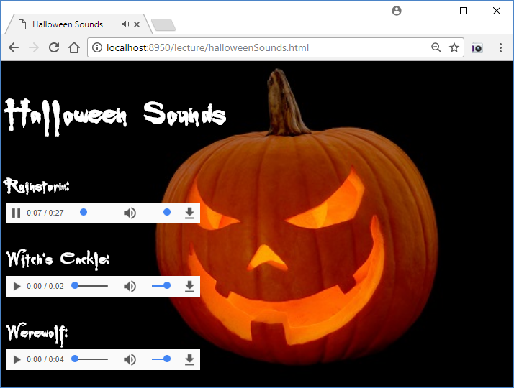
Background Image
1
Notes:
1. Skip this slide the first time through and refer back to it as things come up.

Slide 16
Background Image
To display an image as the background of your web page, apply CSS to your web page body element. Specifically, use the background-image property to specify a URL to an image file. For example:
  body {background-image: url(../images/pumpkin.jpg);}
  When you use a background image, pick an image that won't blend in with or hide your page's text.
  Suppose that a web page’s background image is smaller than the browser window’s viewport (the viewport is the large area below the address bar where web page content displays). That can lead to boring dead space surrounding the background image.
  To avoid the dead space problem, the default behavior is for the browser to fill the entire viewport by displaying multiple copies of the image using a tiled layout. This can look bad, so be careful.
1
2
3
Notes:
1. The background-image property uses a URL value to specify the background image’s file. Note the URL value’s syntax – url and then parentheses around a path and a filename.
Optionally, you can surround the path and filename with single quotes or double quotes.
2. Go to the Halloween web page and note how the text's white color contrasts nicely with the dark picture.
3. Using my IDE, I change the Halloween web page's body rule to what's shown above and note the tiled pumpkins.

Slide 17
Background Image
Another strategy for avoiding the dead space problem is to is to have the browser automatically expand the background image to conform to the size of the viewport while maintaining the background image’s original shape. That's called scaling.
Here's the CSS code in charge of scaling the Halloween Sounds web page background image:
  body {
  background-image: url(../images/pumpkin.jpg);
  background-size: cover;
  background-attachment: fixed;
  background-position: center;
  }
1
2
Notes:
1. In maintaining the image's shape, the image's width and height ratio is preserved.
2. We describe the bottom 3 property-value pairs on the next slide….

Slide 18
Background Image
  Used together, background-size: cover and background-attachment: fixed tell the browser to “cover” the web page’s background by scaling the image such that one of the background image’s dimensions will match the viewport and the other dimension will be greater than the viewport. The end result is that the viewport gets covered completely and (unless the image scales perfectly with the viewport), some of the image will be cropped.
  The background-position property with a value of center tells the browser to center the background image horizontally. If you omit the background-position property, the browser positions the background image with its top-left corner in the top-left corner of the browser window’s viewport.
1
2
3
Notes:
1. If you choose a decent picture, the cropping can be unnoticeable.
Go back to the browser display slide and note that the cropping is indeed unnoticeable.
2. On the next slide, the right-side image shows the image with a value of center for its background-position property (see the CSS property-value pairs above the image).
The image is wider than the browser window, and because of the center value, the cropping is symmetrical on the left and right side.
The middle image shows the default left alignment where all the cropping occurs at the right side.
The left image shows another option, which is not as nice:
I read the property-value pairs and show the dead space.
[3. You can use a second value to specify the image’s vertical position.
If you provide just one value, then the second value defaults to center vertical alignment, which works fine most of the time.
For the first value, you can use pixels from the left edge or left, center, right.
For the second value, you can use pixels from the top edge or top, center, bottom.]

Slide 19
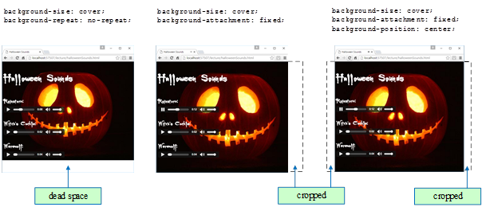
Background Image

Slide 20
Web Fonts
For standard fonts (such as Tahoma and Courier New), you can be reasonably confident that those fonts will be installed on users' computers and they will work, but to be safe, you should always include a generic font family in your CSS font-family rules. On the other hand, non-standard fonts will not be pre-installed on users' computers, so to get them to work, use a CSS at-rule. Using such a rule means that when the user loads the web page, the web server sends the web page file plus a web font file.
Here's a CSS at-rule from the Halloween Sounds web page:
  @font-face {
  font-family: Buffied;
  src: url(../fonts/Buffied.woff2) format("woff2"),
  url(../fonts/Buffied.woff) format("woff");
  }
  h1, h3 {color: white; font-family: Buffied, serif;}
1
2
This at-rule creates a Buffied font family, so it can be used in a regular rule later on.
4
3
Notes:
1. They're called at-rules because they use the @ symbol - see the code fragment.
The W3C states that at-rules "define special processing rules or values for the CSS document."
[For more at-rule details, see http://www.w3.org/TR/css3-syntax/ and https://developer.mozilla.org/en-US/docs/Web/CSS/@font-face.]
2. I read the callout and note how Buffied connects the two rules.
3. Even though the Buffied web font should be downloaded successfully, you should still include a generic font family, as shown here with serif.
4. Note the different web font files with .woff2 and .woff extensions. Next slide....

Slide 21
Web Fonts
  In the previous slide's at-rule, note the url values with.woff2 and .woff files.
  Those two files use the WOFF (Web Open Font Format) and WOFF 2.0 web font formats. The WOFF 2.0 web font format does a better job with compression, with WOFF 2.0 files showing a 30% reduction in file size when compared to WOFF files.
  Current browsers support WOFF 2.0 files, but to accommodate older browsers, you should probably include both WOFF and WOFF 2.0 files in your at-rules.
  To help the browser determine whether it's capable of displaying a particular web font, you should provide a format value after each url value - "woff2" for WOFF 2.0 files and "woff" for WOFF files.
1
2
3
4
5
Notes:
1. I go to the previous slide and show the 2 url values.
The browser will load the first file that uses a format that the browser supports.
2. The WOFF format was introduced in 2010 and WOFF2 was introduced in 2016.
3. I go to the previous slide and show the format values.
[4. For security reasons, some web servers will transmit font files (as well as audio and video files) only if the file's type is added to the server's configuration.
5. As an alternative to storing web fonts on your own server, you can use a Google web font and access the web font via a web server hosted by Google.
https://www.google.com/fonts#QuickUsePlace:quickUse/Family: shows how to link to a Google-hosted CSS file that contains the code necessary to use a Google web font.]

Slide 22
Web Fonts
  In searching for web fonts on the Internet, you’ll probably have a hard time finding WOFF and WOFF 2.0 files. But it’s easy to find files with the extension .ttf, where ttf stands for TrueType font.
  If you’d like to use a TrueType font file on your web page, you can do so, but…
  With WOFF and WOFF 2.0 files both showing a significant reduction in file size when compared to TrueType font files, you’re better off using a file converter tool to create WOFF and WOFF 2.0 versions of the TrueType font file and using the newly created files in your web page.
  You should be able to find free file converter tools on the Web. For example, https://font-converter.net works well and is easy to use.

Slide 23
Video
1
In the past, users had to install a plug-in to play a video from a web page.
HTML5 provides a video element, which allows users to play video files directly from their browsers without the need of a plug-in. For example:
  <video src="stBernardClimbsFlagPole.mp4"
  width="350" height="260"
  preload="metadata" controls
  poster="stBernardClimbsFlagPole.jpg"></video>
2
3
Notes:
1. The video element is fairly similar to the audio element.
2. Like the audio element, the video element requires a start tag and an end tag.
Coming up, I'll show content you can put inside the tags.
3. Note that the example uses an mp4 file.
Coming up, I'll talk about different video file types.

Slide 24
Video
Attributes for the video element:
  src – Specifies a path to a video file.
  width & height – Specifies the size of the video's display box in pixels.
  preload="metadata" – Suggests to the browser to download information about the video file (dimensions, duration, etc.), the first frame, and possibly a few additional frames, when the page initially loads as opposed to when the user presses start on the control bar.
  poster – Specifies an image that displays while the video is not playing.
  controls – Causes a control bar to display (start, pause, and volume).
1
2
3
4
5
Notes:
1. By preloading the first frame, that enables the browser to display the first frame in the video box whenever the video is not playing.
But the browser uses the preload attribute only as a suggestion – it’s ultimately up to the browser to decide whether to download the video or its meta information before the user clicks the play button.
2. To decrease the delay when the user presses the play button, you can specify preload="auto", which asks the browser to preload the entire video, not just the video's metadata information.
[To avoid possibly unnecessary bandwidth usage, you can specify preload="none".]
3. If you want to be sure that an image is displayed in the video box while the video is not playing, use the poster attribute to specify an image file.
4. You should always include the controls attribute.
[5. You should normally avoid using the autoplay and loop attributes.]

Slide 25
Video
  Unfortunately, different browsers support different video file formats. To handle that situation, you can omit the video element's src attribute and, instead, include source elements between the video element's start and end tags. For example:
    <video width="397" height="225" preload="metadata" controls
    poster="../images/groceryStore.jpg">
    <source src="../video/swedishAd.mp4" type="video/mp4">
    <source src="../video/swedishAd.webm" type="video/webm"></video>
  For maximum browser compatibility, include source elements for both of these popular video file formats: .mp4, .webm
  To help the browser determine whether it's capable of displaying a particular video file, you should include a type attribute, as shown above.
  If you find only one file format for a particular video, use a file converter (e.g., http://www.online-convert.com) to create files with the other formats.
1
Notes:
[1. The type attribute is part of the source element specification, but not part of the video element specification.]

Slide 26
Video
Here is the body code for a TV advertisements web page at http://teach.park.edu/~jdean240/lecture/tvAds.html:
  <body>
  <h1>Television Advertisements</h1>
  <h3>Kid in a Swedish Grocery Store:</h3>
  <video width="397" height="225" preload="metadata" controls
  poster="../images/groceryStore.jpg">
  <source src="../video/swedishAd.mp4" type="video/mp4">
  <source src="../video/swedishAd.webm" type="video/webm"></video>
  <h3>Doritos Kid:</h3>
  <iframe width="400" height="225" allowfullscreen
  src="http://www.youtube.com/embed/VxzhGPrHCKI?rel=0"></iframe>
  </body>
1
2
Notes:
1. Before going to the website, let's examine the code…..
I discuss each of the video element's attributes and the source elements.
2. We'll discuss the iframe code on the next slide, but first, I demo the web page.

Slide 27
Video
As an alternative to playing a video directly from a web page, you can use an iframe element to play a video on an external web page. For example:
  <iframe width="400" height="225" allowfullscreen
  src="//www.youtube.com/embed/VxzhGPrHCKI?rel=0"></iframe>
Advantages of using an iframe element to play a video on an external web page:
  It's easier to find web pages that host videos (YouTube is huge!) than to find video files or create your own video files.
  You don't have to use up storage space on your own web server.
Advantages of using the video element:
  Doesn't require the user to install a video player plug-in.
  Not dependent on the external web server continuing to host the video.
  You can use JavaScript to customize your video, and you can avoid an external web page's customizations (like advertisements).
1
Notes:
1. Note the allowfullscreen attribute, which enables users to expand the video to full-screen mode.
Full-screen functionality is automatically available if you use the video element, but with the iframe element, it's disabled by default.

Slide 28
Chapter 7 - Quiz Questions
For the audio element, what attribute causes a play, pause, stop, volume device to display ?
  controls
  play
  user="in control"
When displaying a background image, the default browser behavior is:
  Display the image using its natural size, with white space filling in gaps within the viewport.
  Fill the entire viewport by expanding the image if necessary.
  Fill the entire viewport by displaying multiple copies of the image using a tiled layout.
Notes:
#1: a
#2: c

